Slide 1
Brunel Buy and Sell
Android Application User Interface
Group 15

Slide 2
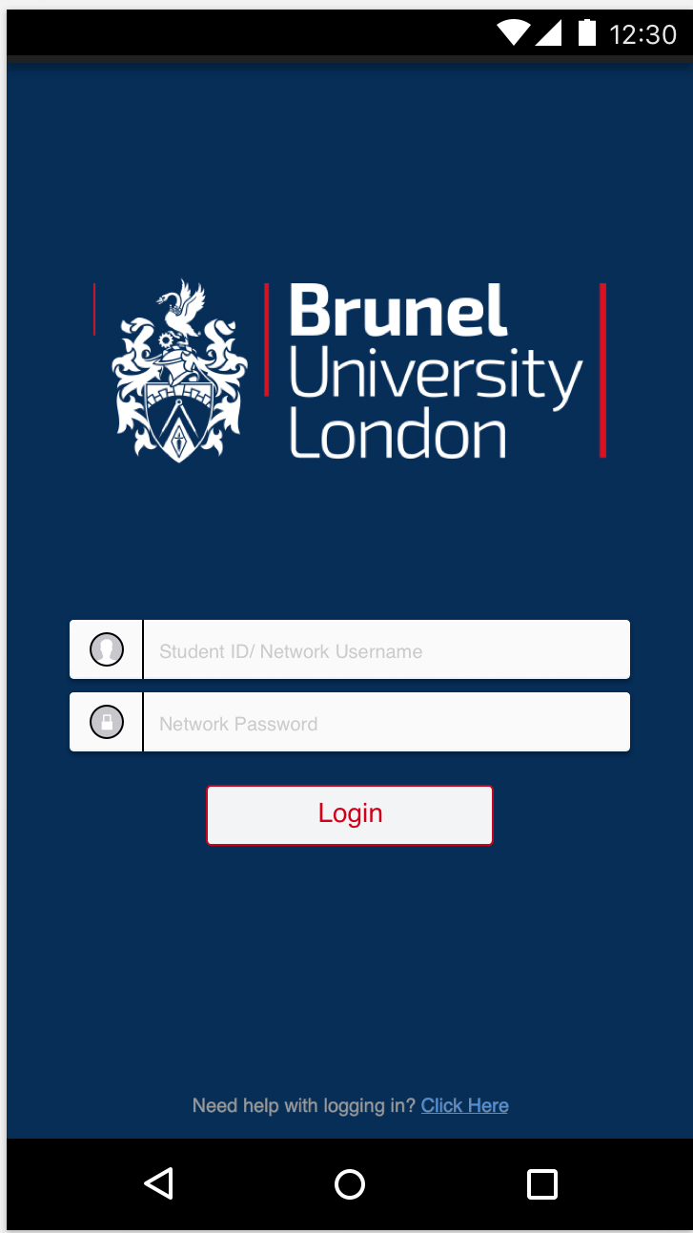
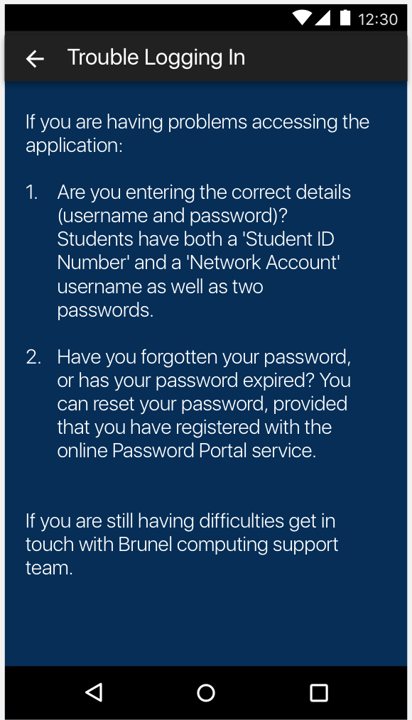
Login / Login Help Screen
This will be the initial screen the user will be shown when they access the application
The user will be able to login using their Brunel login credentials, this is so that only Brunel students can access the application, as that is the target audience this app is designed for
There is also an additional screen which helps the user on how to login into the application, this acts as guidance for those users who are having trouble logging in.
The design is inspired from the Brunel website, hence the Brunel coat of arms and dark blue design throughout the application, helping the app to be more tailored and familiar to the Brunel students

Slide 3
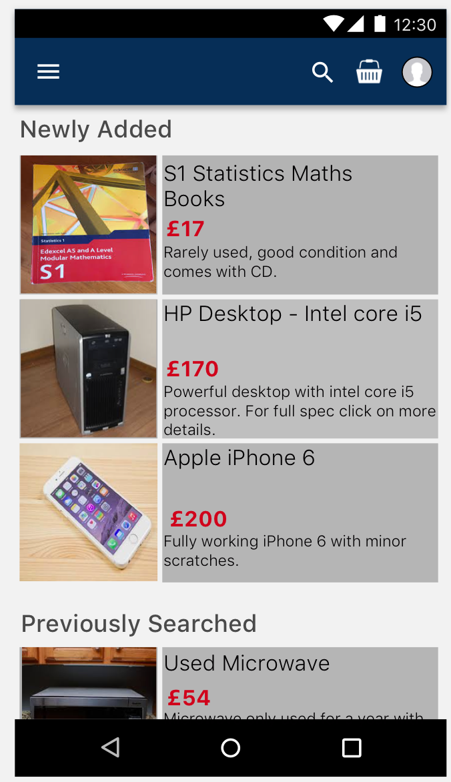
Home Page Screen
This will be the screen that is displayed once the user passes the login screen
The screen will display newly added items by other sellers and items that have been previously searched by the user
More information on the product can be viewed by clicking on the desired item, this will view the product description screen

Slide 4
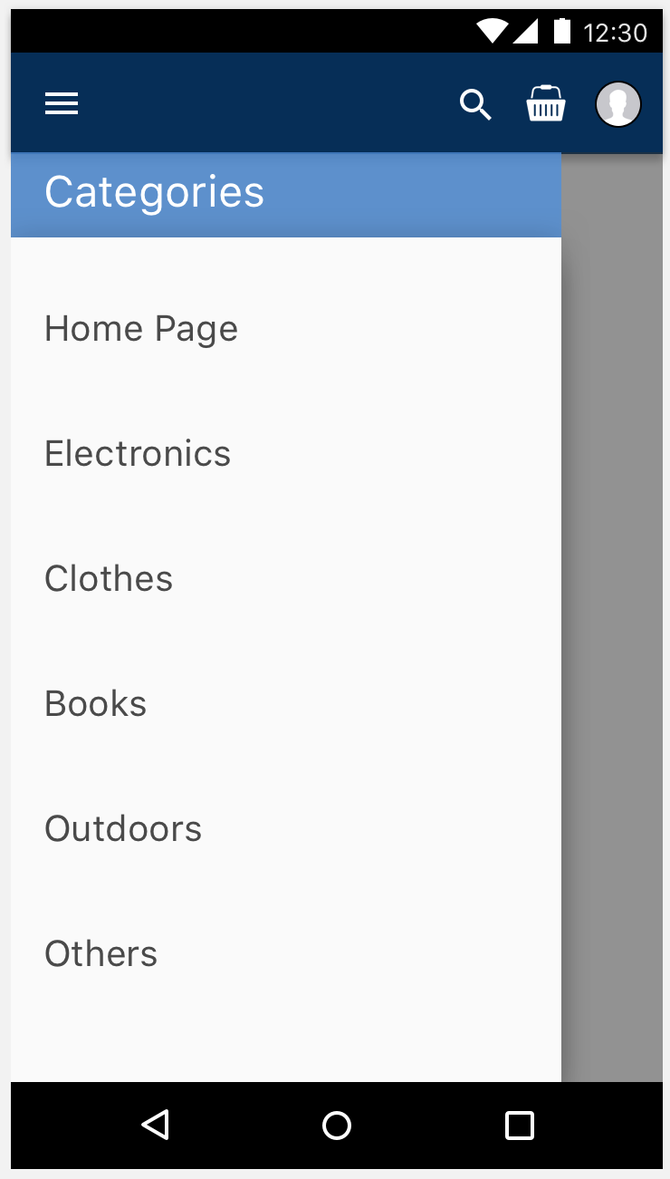
Category Bar
The category bar can be accessed by clicking on the icon on the top left corner and this will display a variety of category, so if the user is looking for a specific product the user can select the category of the product and view items in that category to find the desired product
The category of a product is set by the seller

Slide 5
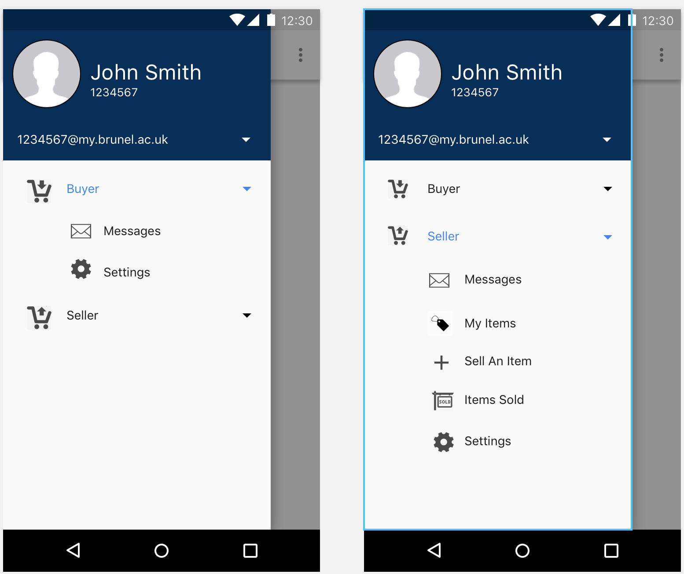
Buyer/ Seller Interface
The app will have to interfaces, one for the buyer and one for the seller, so it allows the user to buy from other sellers and sell to other buyers
The buyer interface will allow the user to see listed items from other sellers and buy the desired items
The seller interface allows the user to list items so other buyers can see the listed items and buy from the user.
There will be a separate messaging service for the buyer and seller interface, so it doesn't confuse the user.

Slide 6
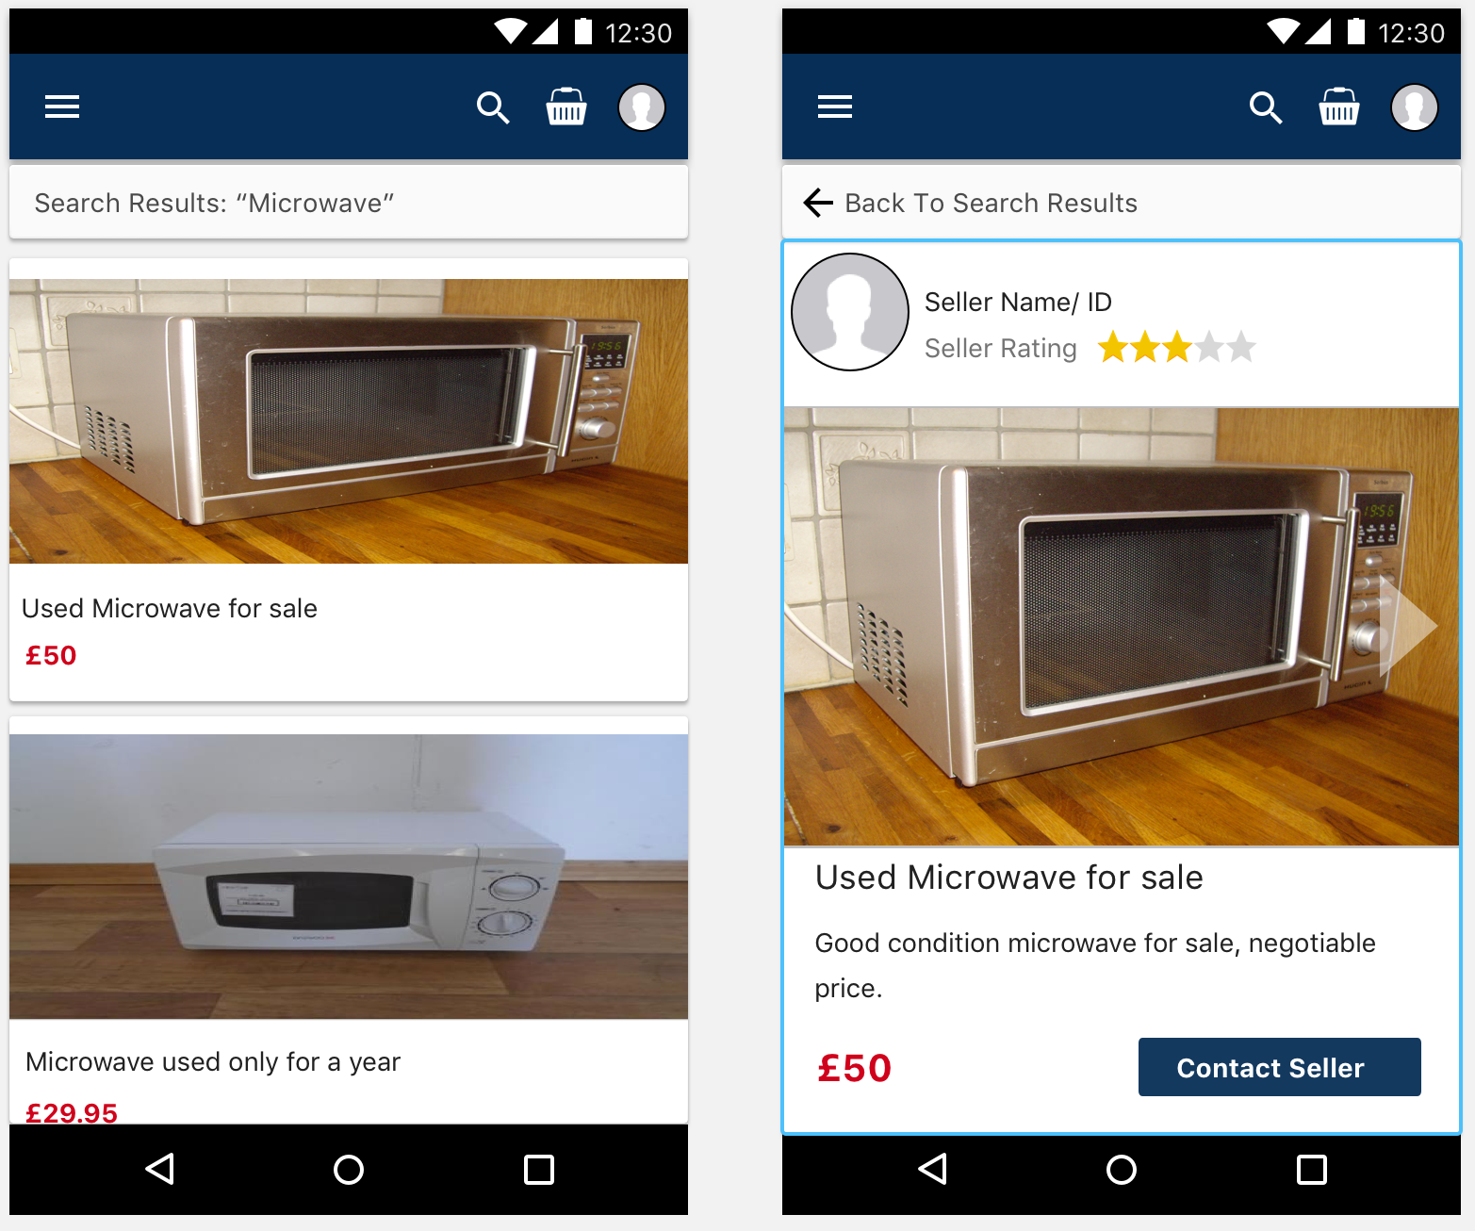
Product Information
The product information will display the product detail in more information
This screen will display the information and photo/s provided by the seller
Also it will display the user rating, other users can make sure they are buying/selling from/to a trustworthy user, the rating will be left by other users who have brought/sold an item from/to the user

Slide 7
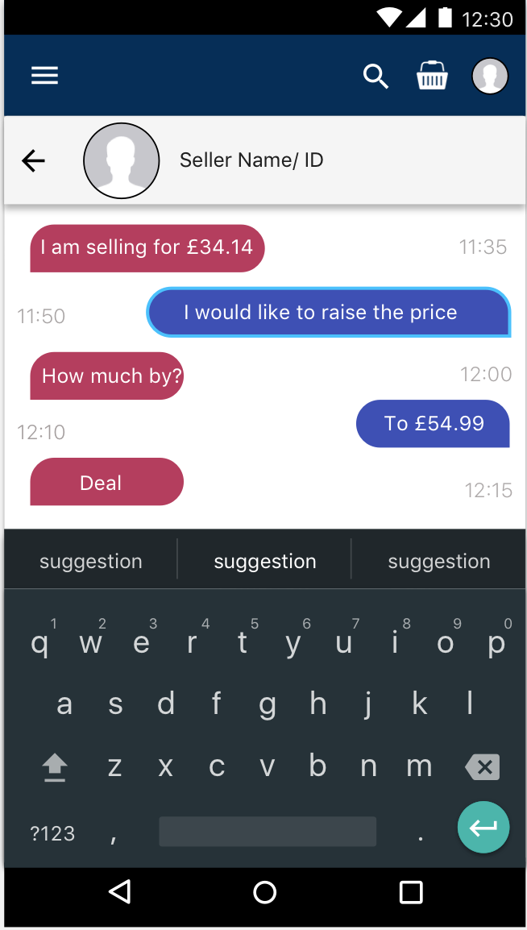
Buyer/Seller Messaging
This shows the messaging service in the app, which allows users to communicate with other users about any queries they have about the item.
Also the messaging service could be used to negotiate a price between the buyer and seller.

Slide 8
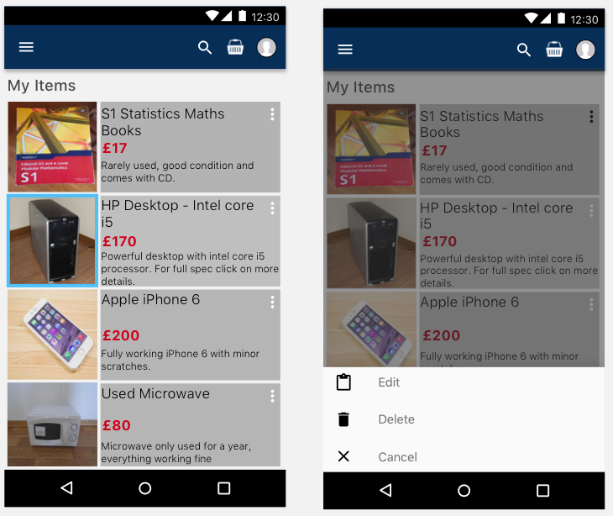
My Items screen
This screen will display information of all the items listed by the user
It will also allow the user to edit information of items or delete items from listings

Slide 9
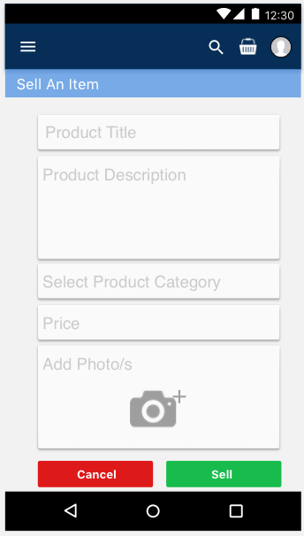
Sell An Item screen
This screen will be displayed when the user decides to list an item on the app

Slide 10
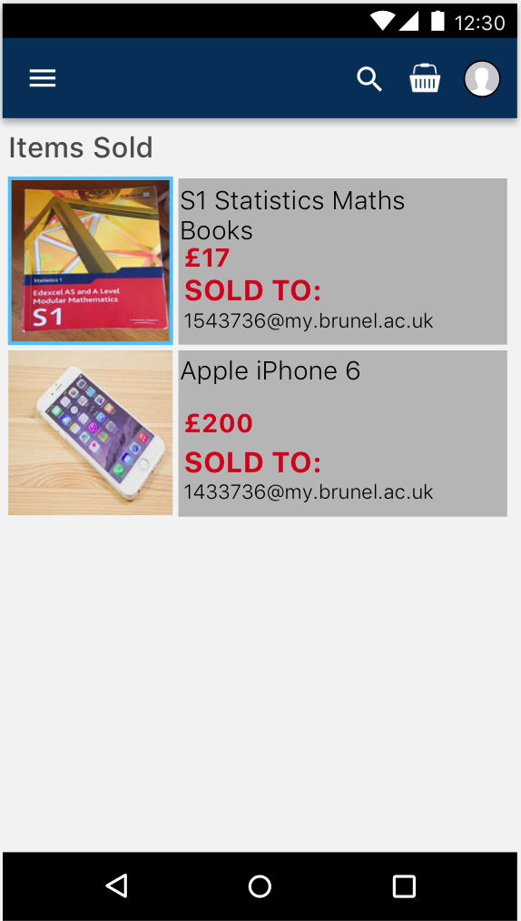
Items Sold screen
This screen will show all the items sold that were listed by the user
It will include information such as who the item was sold to and for how much it was sold for

